Slide 1
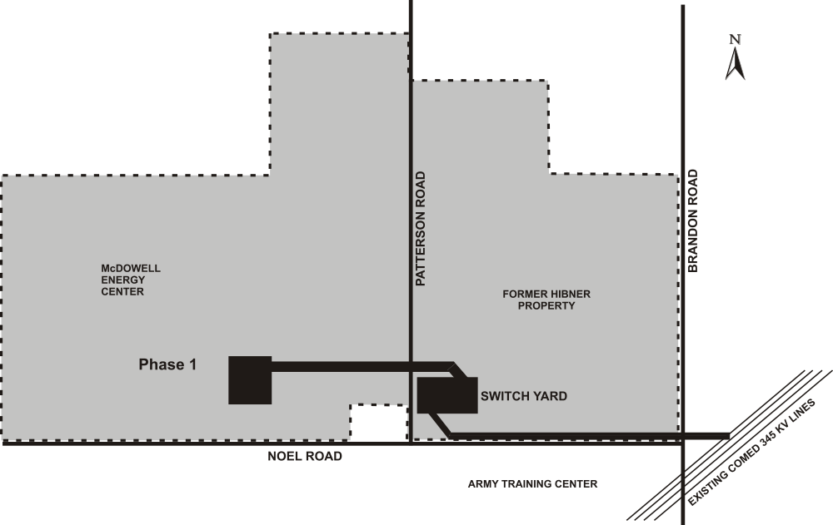
Exhibit II
Elwood Energy Project Area
Elwood, Illinois
Page 1 of 2
The Elwood Energy Project Area consists of the shaded area within the dashed line.

